Slide 1
ARL RFE Application
Rachel Choi and Sami Glasco (F15B1)

Slide 2
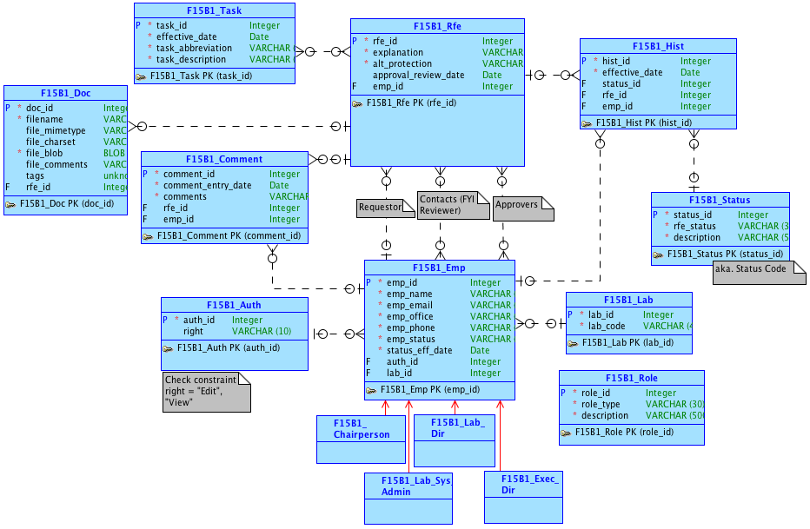
Conceptual Model

Slide 3
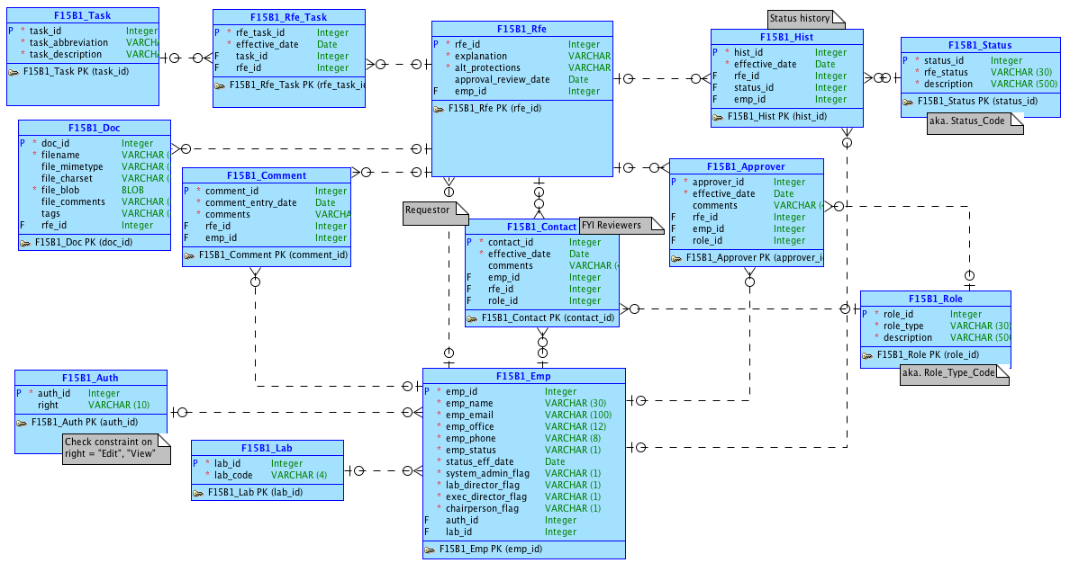
Logical Model

Slide 4
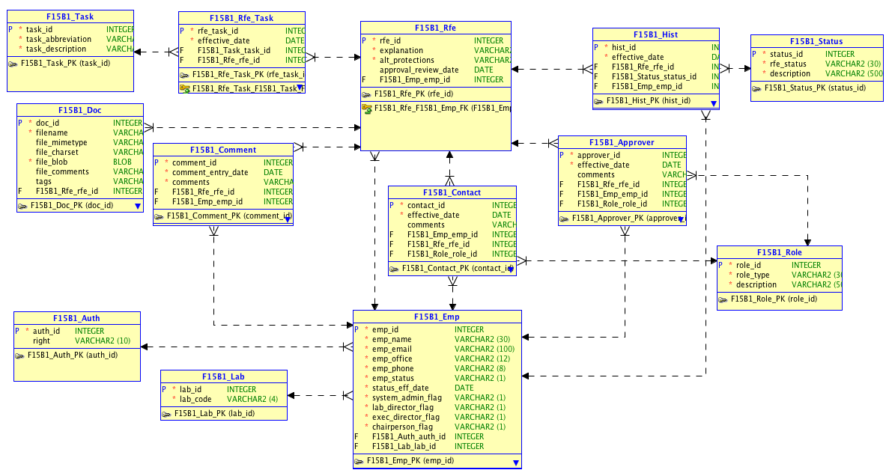
Relational Model

Slide 5
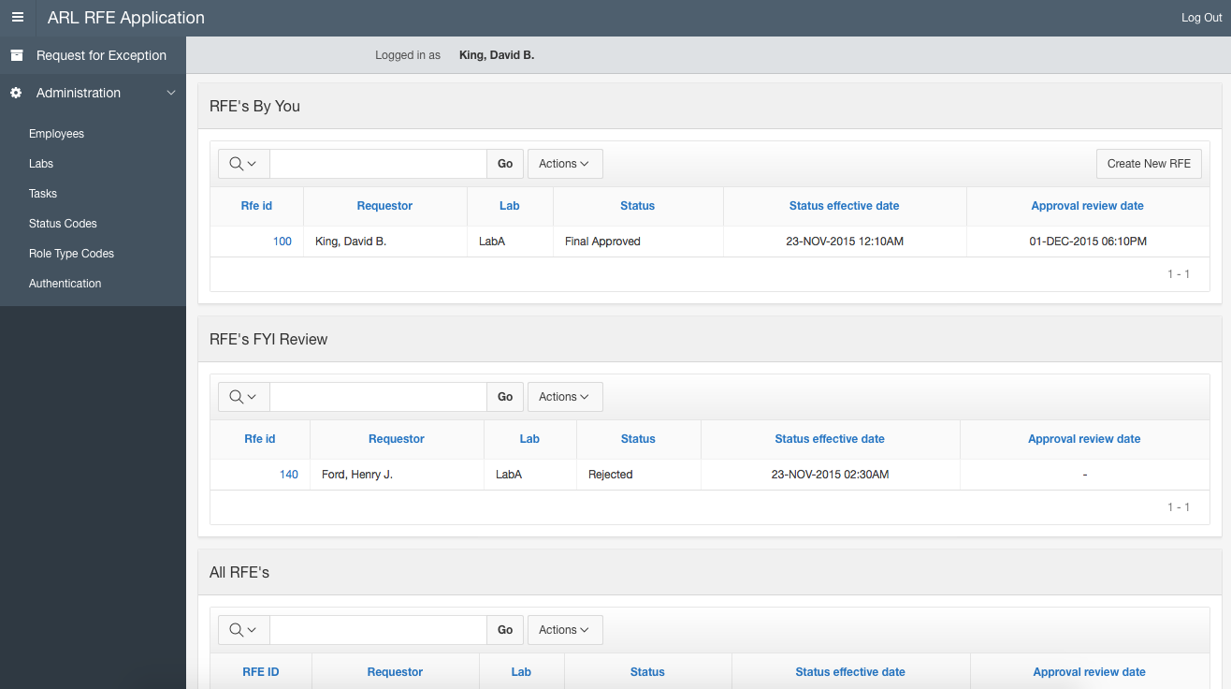
Requestors view of the RFE page.
RFE’s the logged in employee is a contact of.

Slide 6
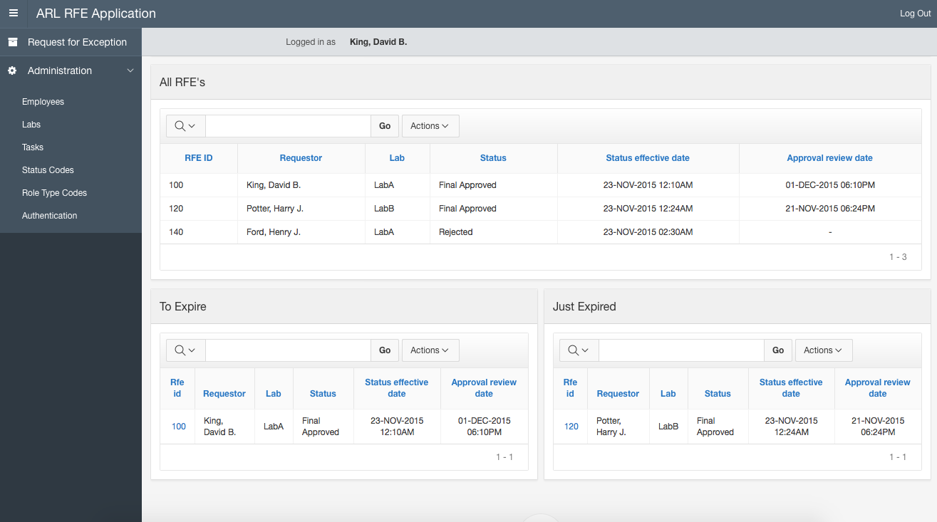
RFE’s that are about to expire in 35 days.

Slide 7
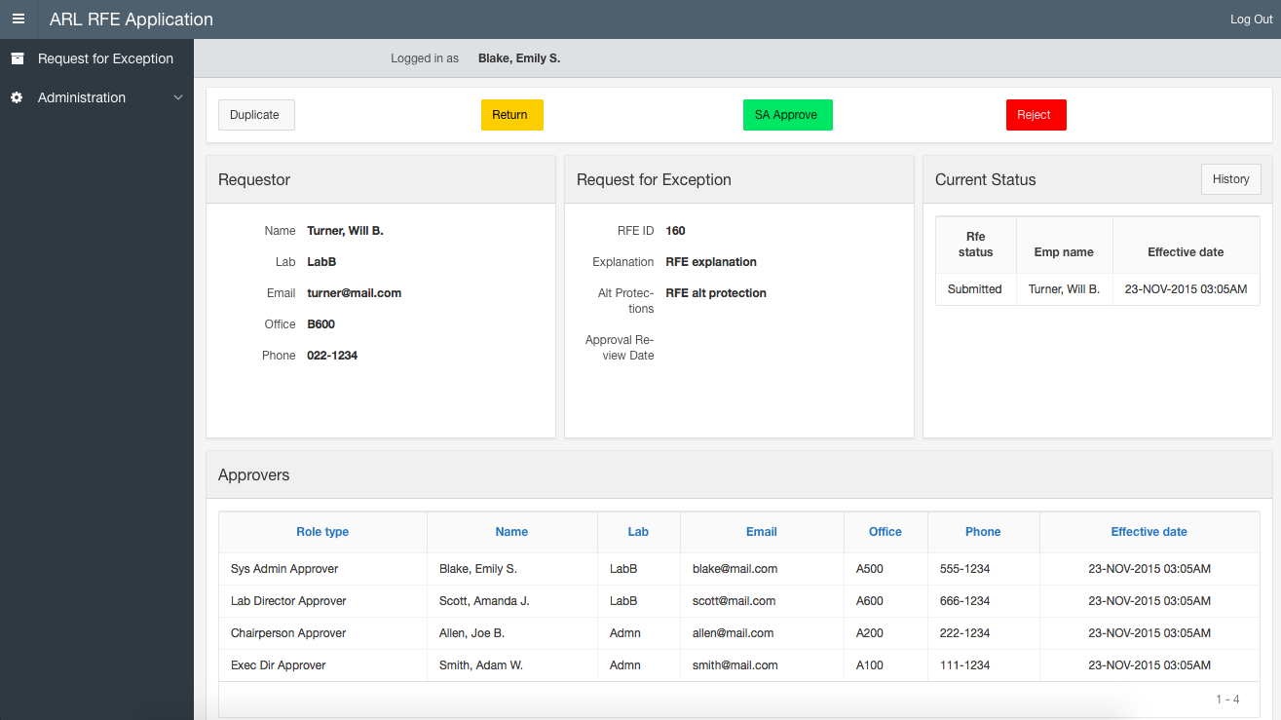
System Admin view of the RFE Details page.

Slide 8
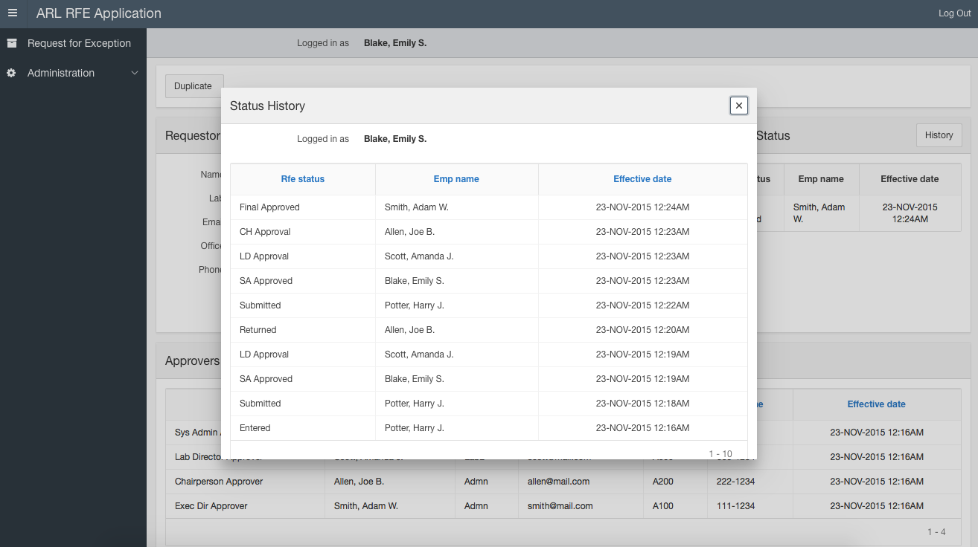

Slide 9
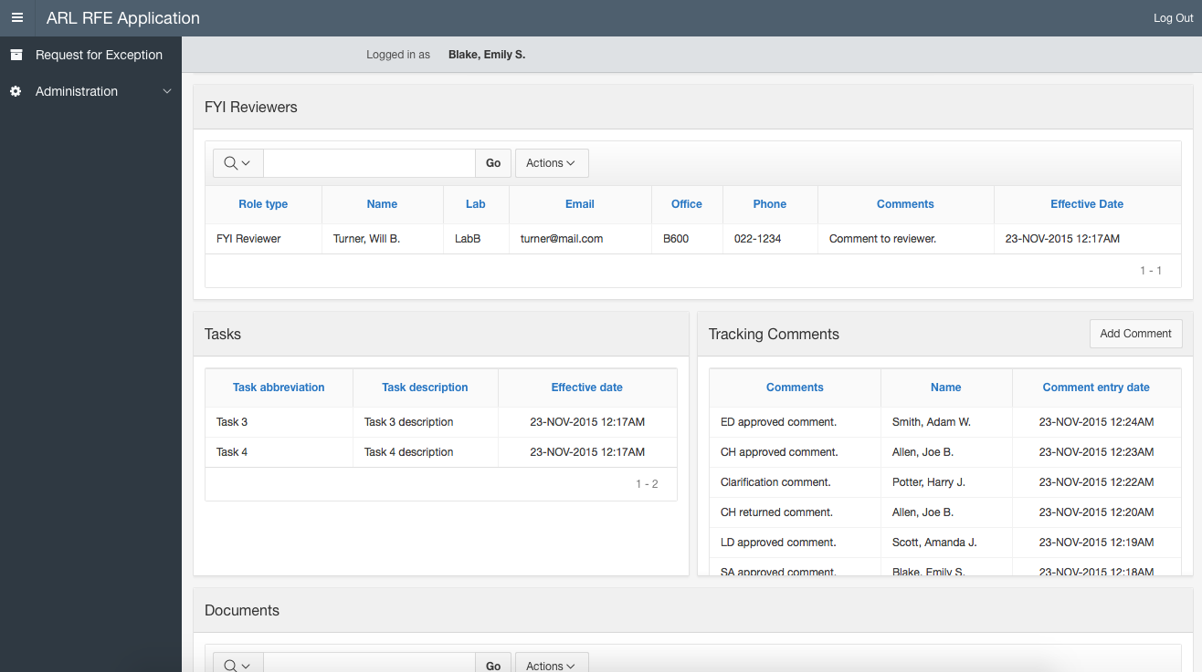

Slide 10
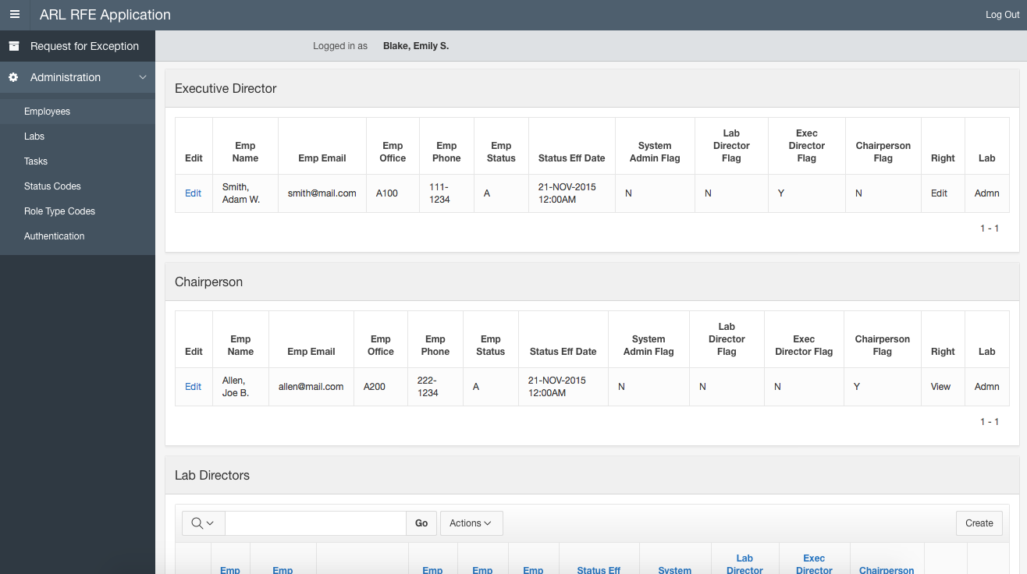

Slide 11
Part 2: APEX Mobile App

Slide 12
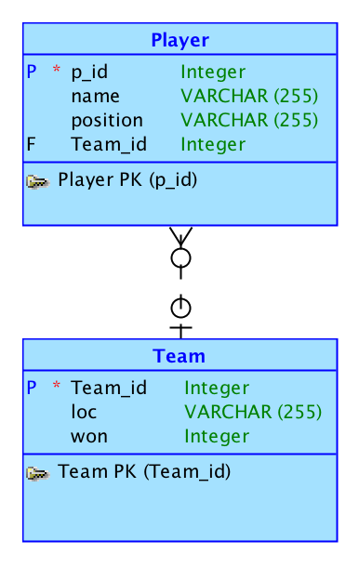
Conceptual Model

Slide 13
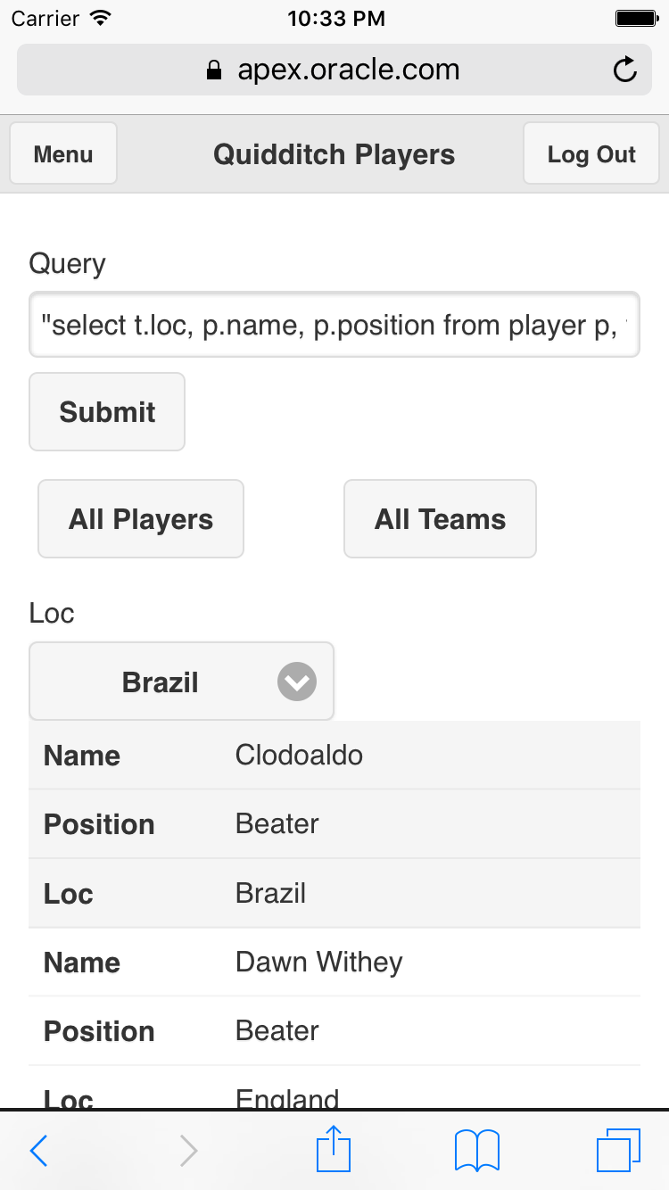
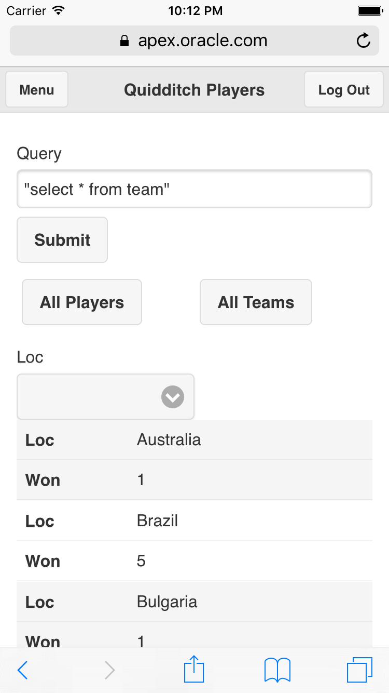
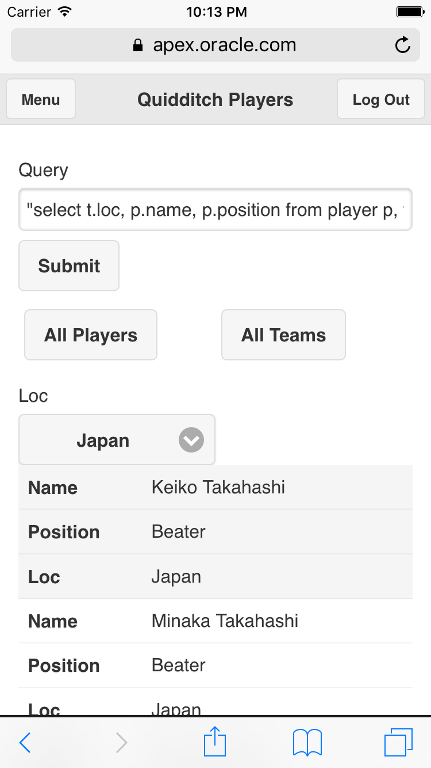
This application will allow you to view a few Quidditch teams, their respective players, and number of World Cup wins.

